Slide 1
What is StreetSafe?
StreetSafe is a non-crime anonymous online reporting tool to collect data to find out where people feel unsafe and why - 72% women!
It was launched on Thursday 2nd September 2021 and a pilot will run for 90 days to analyse its scope and how officers have used the tool.
Members of the public reporting online can choose which contributing factors may be making them feel unsafe – Environmental, such as the area being poorly lit, or Behavioural, such as verbal harassment. This indicates where improvements can be made.
Users can submit demographic information even though the reporting tool is anonymous.
Data from StreetSafe is uploaded onto a central hub where police officers across the country can access it.

Slide 2
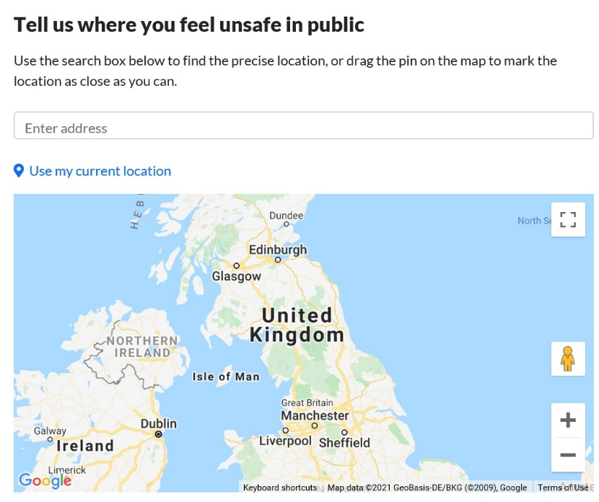
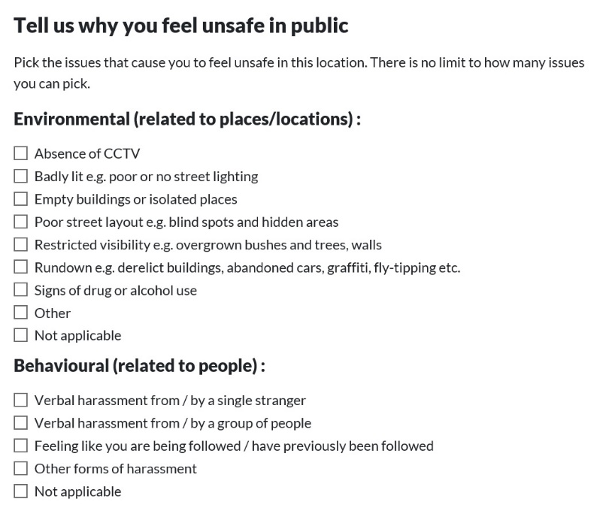

Slide 3
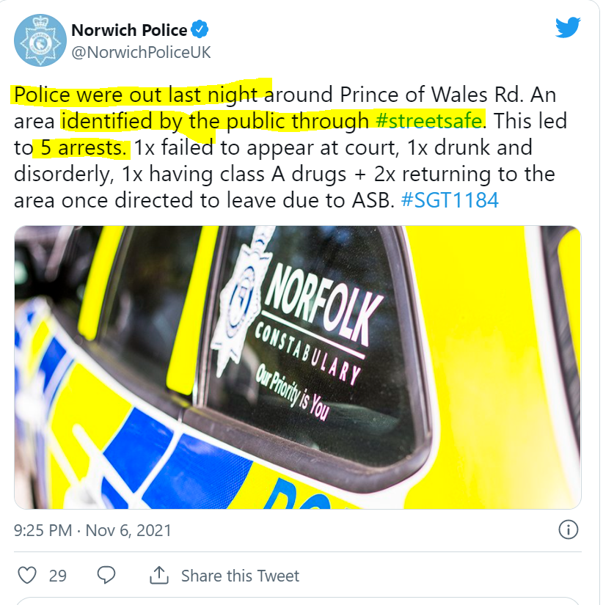
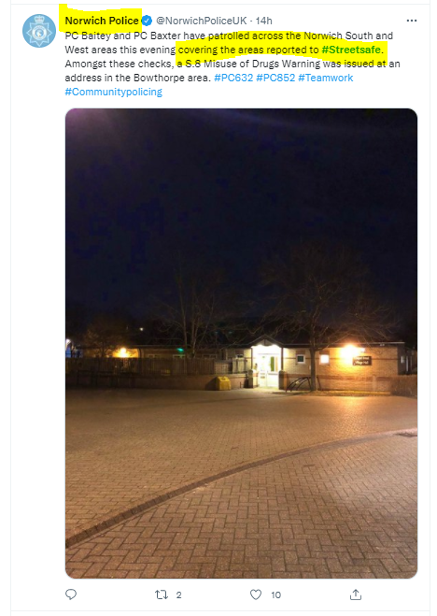
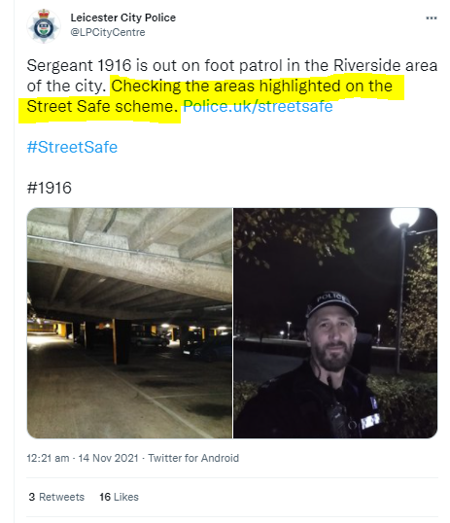
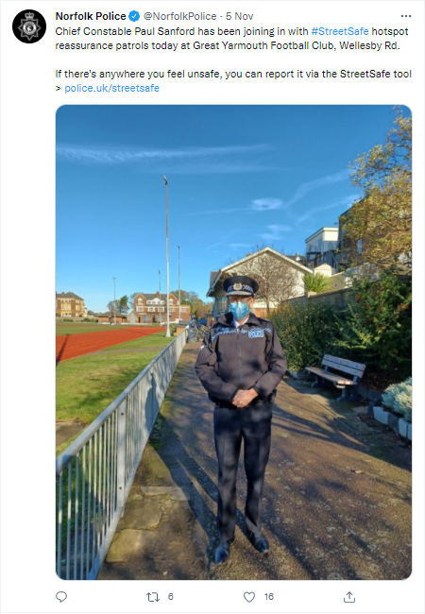
“You said, we did!”

